Slide 1
User Essentials
Jasmine Johnson

Slide 2
Does your screen look like this?
Why haven’t you switched to the 10g Layout yet!?

Slide 3
Dashboard Design
New search functionality from your personal page
The ability to drag and drop to customize your dashboard to fit your needs

Slide 4
Suggested Tips
Customizing user specific settings
My Preferences → General
Can anyone tell me what the patient “Hotlist”is?

Slide 5
Is there a way to see different calendar views?
Daily View
Multiple View

Slide 6
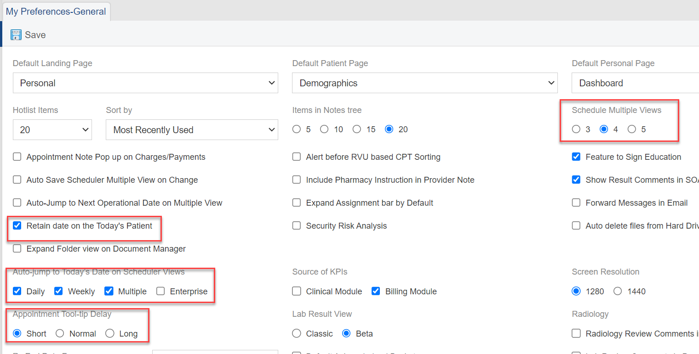
Calendar Preferences
Retain date on Today’s Patient
Auto – Jump to today’s date
Appointment Tool-tip Day

Slide 7
Classic Lab View

Slide 8
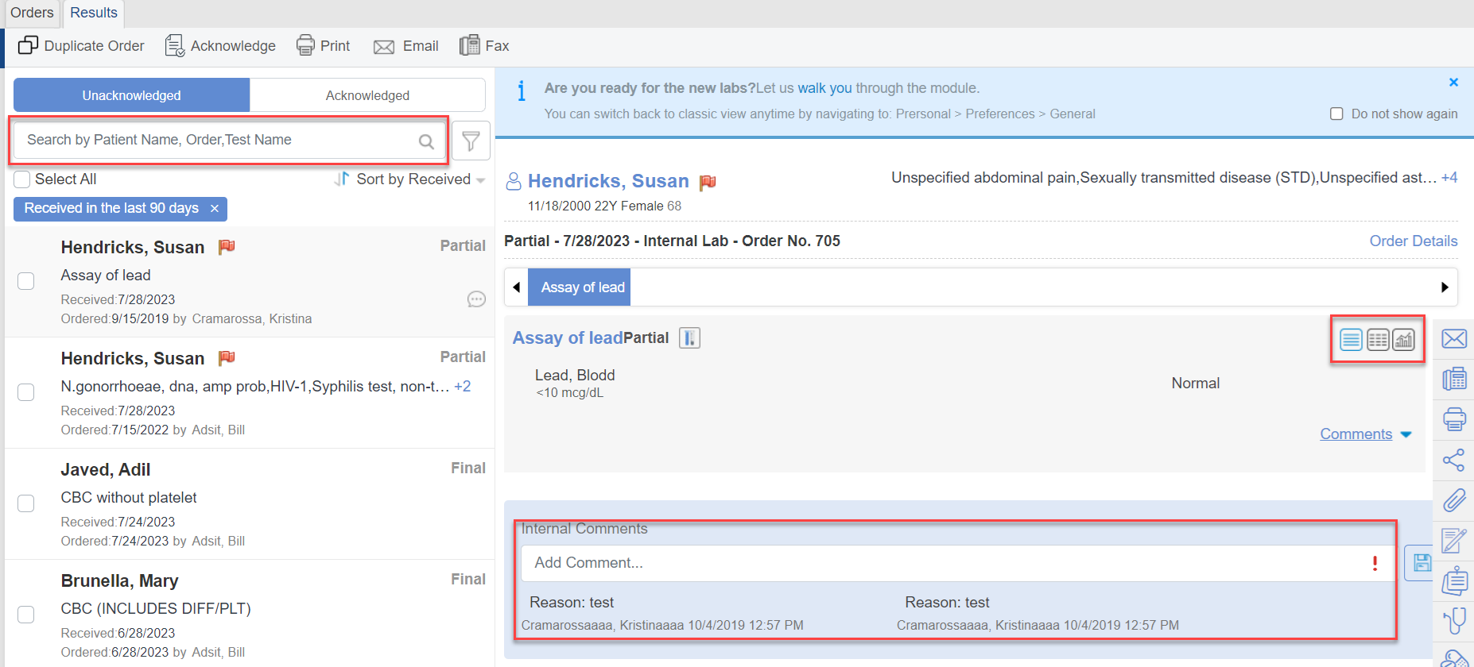
Beta Lab View
Improved filtering functionality
Internal comments
Graphs – show trends over time

Slide 9
Suggested Tips
My Preferences -> Patient

Slide 10
Patient Banner Customization
Patient Portal Status – Pending / Last log in date
Custom Tags
View SFS% inside billing tile
Enable / Disable Banner Options ( Settings)

Slide 11
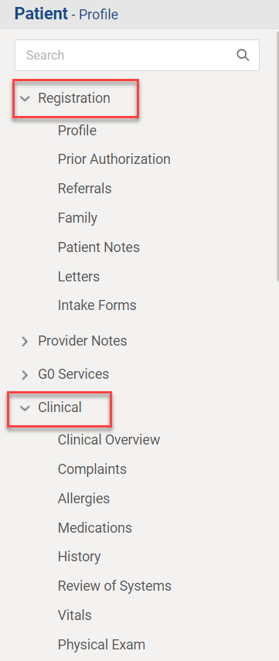
Can I have items already expanded on the tree menu?
Enable drag allows you to drag and drop items.
When selecting items in the Expand tree Menu, they will show as expanded inside of the patient's chart.

Slide 12
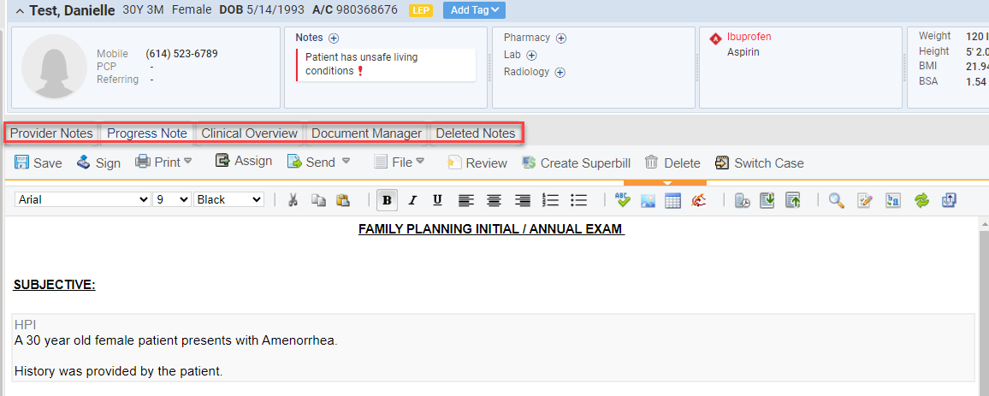
Customize Provider Note Section
If you use “Smart Phrases”, they need to be turned on inside of preferences to be able to use.
You can select what tabs are most helpful to be able to view while inside your note.

Slide 13
Have you had a patient refuse height and/or weight?
Inside Cure, you can document refusal reasons.
Auto- populate height/ weight will populate the most recent measurements if the patient has been seen recently

Slide 14
Patient Refusal Documentation

Slide 15
Suggested Tips
My Preferences -> Quick Links

Slide 16
What are Quick Links?
Selections made will show at the top left of your Screen.

Slide 17
Other helpful tips and Shortcuts

Slide 18
Are Demographic Fields Mandatory?
Settings -> Practice -> My Practice Settings -> EHR
You can make certain fields mandatory by selecting appropriate ones for your clinic in settings.
(i.e Perferred pronoun, Support contact.)

Slide 19
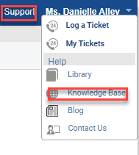
FAQ’s
We have a great feature inside of CureMD, that is a wealth of knowledge.
To access CureWiki you click on support -> knowledge base
Best way to find answers is to use the prompts to direct you.

Slide 20
Walk Me
Does anyone know what “Walk Me” is?
Tool inside of Cure that walks you step by step through a scenario (i.e how to check out a patient)
The “Walk Me” button is on the left side of the screen at the bottom.

Slide 21
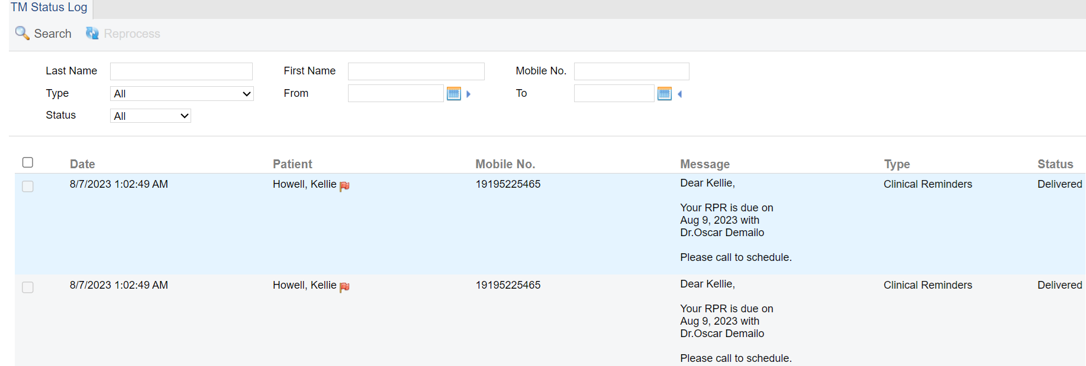
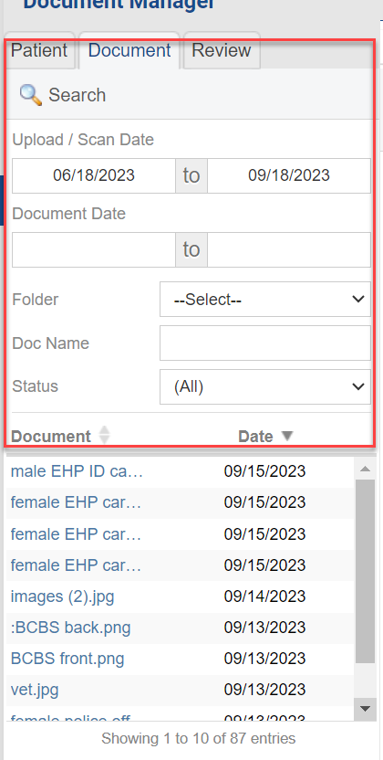
Rapid Fire Facts
Add Practice Logo Directly to your Database
Document search by name and Date
View documents from inside patient chart
Ability to track Text Messages and Fax logs
Personal -> Admin -> Fax & TM Logs
How else can CureMD help you?

